Slide 1


ZCCT
Library Management System Documentation
Date: December 10, 2024.
Prepared by:Abd Alsalam Allawlbi
Supervised By: Dr. Khari Armih

Slide 2

Overview
The Library Management System is a Java-based application designed to manage books and their availability in a library. Users can add, remove, find, borrow, and return books using various commands. The system also provides a way to list all available books.

Slide 3
Features
1
ADD NEW BOOKS OR UPDATE THE QUANTITY OF EXISTING ONES.
2
REMOVE BOOKS FROM THE LIBRARY.
SEARCH FOR BOOKS BY ALL FIELDS.
3
Borrow and return books while maintaining stock levels
4
5
LIST ALL BOOKS WITH DETAILS.
6
INTERACTIVE COMMAND-LINE INTERFACE WITH HELP FUNCTIONALITY.

Slide 4
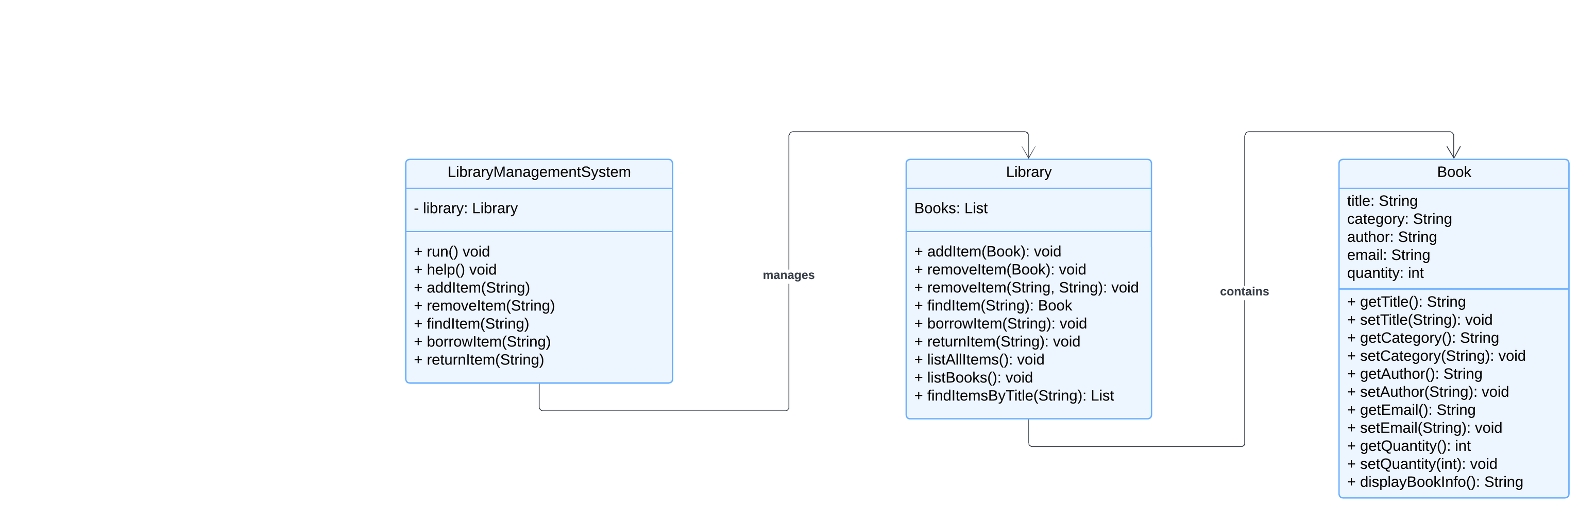
The Class Diagram

Slide 5
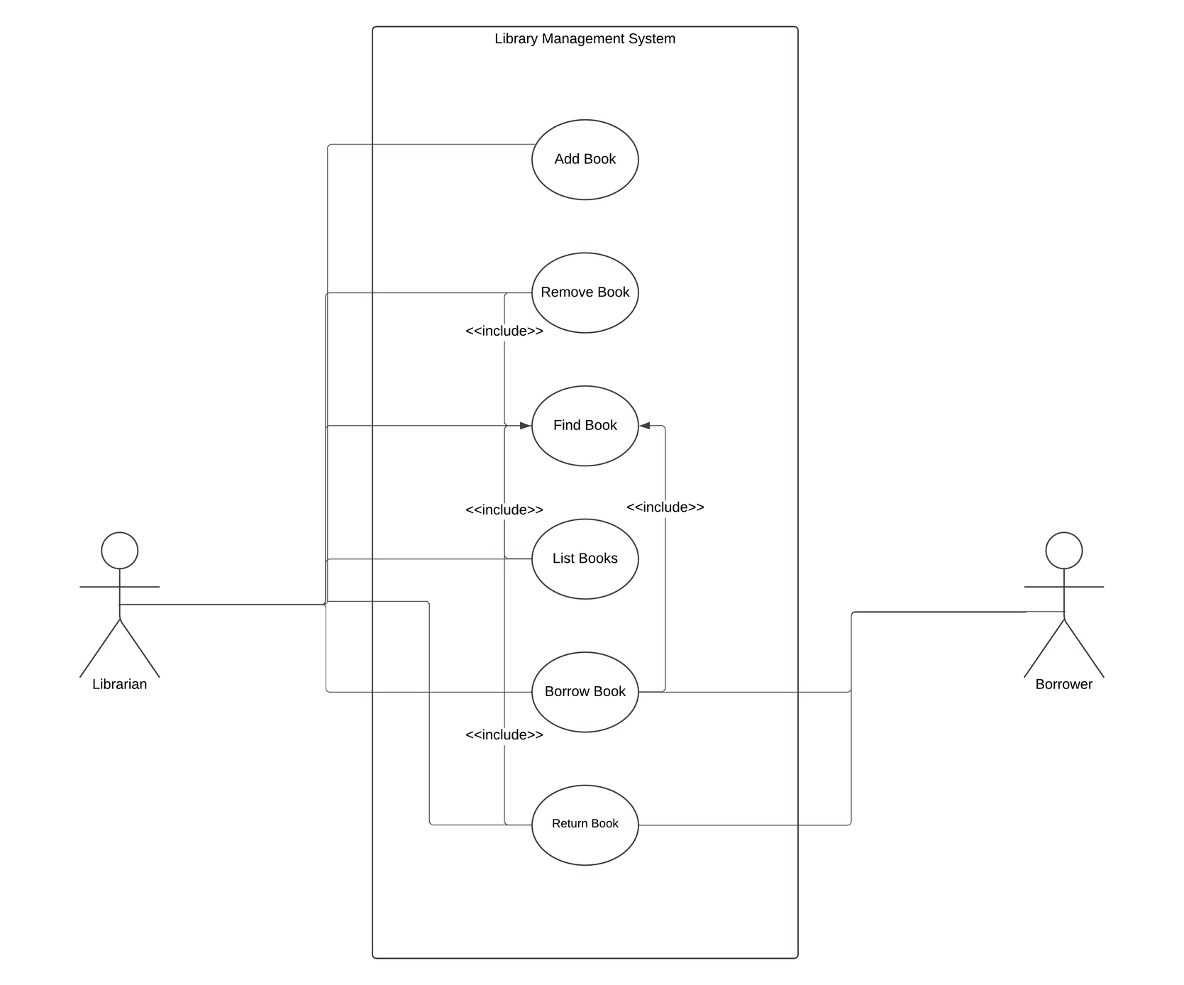
The Use Case Diagram

Slide 6

General Help
Type help to display a list of available commands.
Add a Book
Command: add <title> <category> <author> <email> <quantity>
Adds a new book to the library or updates the quantity if the book already exists.
Example: add JavaProgramming Technical JohnDoe john.doe@example.com 10
2. Remove a Book
Command: remove <title> <author>
Description: Removes a book from the library.
Example: remove JavaProgramming JohnDoe

Slide 7
General Help
3. Find a Book
Command: find <title>
Description: Searches for a book by title.
Example: find JavaProgramming
4. Borrow a Book
Command: borrow <title> <author>
Description: Decreases the available quantity of a book by 1.
Example: borrow JavaProgramming JohnDoe

Slide 8
General Help
5. Return a Book
Command: return <title> <author>
Description: Increases the available quantity of a book by 1, if it hasn't exceeded the maximum stock.
Example: return JavaProgramming JohnDoe
6. List All Books
Command: list all
Description: Lists all books in the library with their details.
7. Exit the System
Command: exit
Description: Exits the application.

